Slide 1
Accelerometer Data from NHANES 2011-2014
Rick Troiano

Slide 2
Objectives
NHANES 2011-2014 protocol vs 2003-2006
Preliminary results (meta data)
Data QC and processing
Release plans

Slide 3
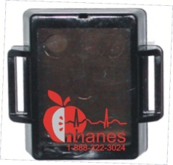
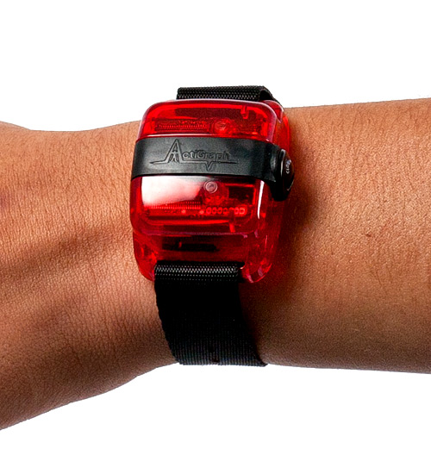
NHANES Accelerometer Protocols
2003-2006 Protocol
2011-2014 Protocol
Ages 6 years +
Waist worn monitor
Splash proof
No swimming or showering
Waking hours only
No objective sleep data
Uniaxial (vertical axis)
1-minute epoch
Ages 3 years + (6+ for 2011)
Wrist worn monitor
Waterproof device
24-hour wear
Allows measures of sleep
Triaxial (X, Y, & Z planes)
80Hz raw data + lux

Slide 4
2011-14 Preliminary Data

Slide 5
NHANES Component Compliance
Over 4 years:
>16,000 participants agreed to wear (including Youth Fitness Survey)
~92% of examinees ages 3 years and older
Acceptance by age group was ~90% or greater
>95% of devices were returned by participants

Slide 6
Data Processing

Slide 7
Starting point: The data
Provided data for 16,460 participants
Device ID, age, gender, day of week
80 Hz accelerometer sampling rate
1 Hz light sensor (lux) sampling rate
Up to 7 full + two partial days
1.66 TB
gt3x Actigraph files

Slide 8
Five stages
Convert data to non-proprietary format
Flag data with potential quality issues
Compute a non-proprietary motion summary
Estimate wake-wear, wake-sleep, non-wear
Merge data from separate files into manageable summary files

Slide 9
Stage 1: Convert raw format
Convert to non-proprietary raw format (“mHealth format”)
Raw data (csv), split by hour
Accelerometer: timestamp, x, y, z +/- 6 g (actually +/- 6.006 g)
Lux: timestamp, lux 0.00 – 2500.00
Expands size to 4+ TB, but simplifies use

Slide 10
Stage 2: Quality control check
Identify anomalies (suspicious/corrupted data)
Some just a few seconds
Some hours
Tests incrementally added
No systematic pattern of problems isolated to a particular device or firmware version were observed

Slide 11
Anomalies observed
“Stuck” signals
Too many spikes
Impossible signals based on gravity
Non-human oscillation
Abnormal signal pattern

Slide 12
Complete days of data
Target: 7 full days (+ 2 partial)
Complete days of data | # participants
7 | 15,965
6 | 91
5 | 72
4 | 83
3 | 76
2 | 68
1 | 68
0 | 20

Slide 13
Stage 3: Motion summary value
Non-proprietary, open-source Monitor-Independent Movement Summary unit (MIMS-unit)
Interpolation
Extrapolation
Filtering
Aggregation
Output minute-level summaries
Computed across ALL (inc. flagged) data
John et al., 2019 J Meas Phys Behav 2, 268-281

Slide 14
Stage 4: Wake/sleep/non-wear
Three pass algorithm
Pass 1:
Trained machine learning algorithm to classify 30s windows
Iterative Spectral Method: Use “reversed ISM”
Experimentally improved sleep/non-wear differentiation
Use three adjacent windows (1.5 min)
Sometimes sleep/non-wear indistinguishable

Slide 15
Stage 4: Wake/sleep/non-wear
Pass 2:
Wear (< 3 min), sleep (< 10 min) and non-wear (< 10 min) are filtered
Uses summation of confidence values across 1.5 min
Pass 3:
Orientation changes used to flip labels from non-wear to sleep, or sleep to non-wear
Output: class per minute (or uncertain)

Slide 16
Classification
Algorithm tuned with small labeled training/test set
Established non-wear
Established sleep (PSG)
Active wear
Performs as well or better than currently accepted approaches on test set

Slide 17
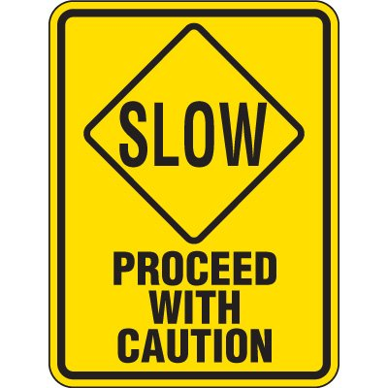
Wake-wear, sleep-wear, non-wear
Estimates must be interpreted cautiously, and will require more time to fully understand. Overall trends seem reasonable, but also many outliers.
We have already identified some possible improvements.

Slide 18
Non-wear detection
8,902 (54%) participants have seven full days of data recorded with absolutely no non-wear detected
For rest, when non-wear detected, some could be sleep

Slide 19
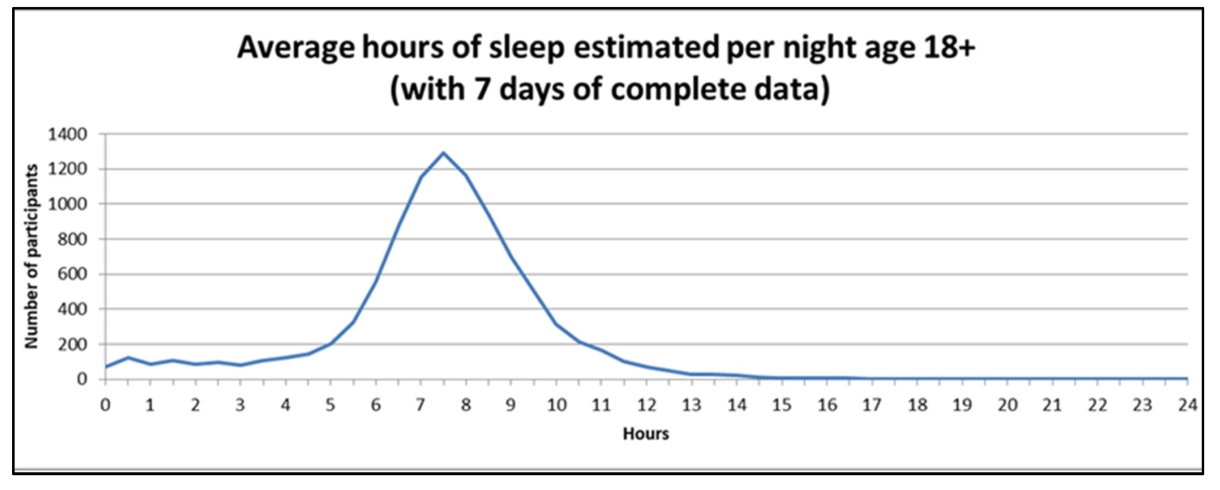
Sleep summary

Slide 20
Data Release Plans

Slide 21
Data Release Plans
High Frequency Data
Intermediate Data
Daily Summary
Advanced
80hz Data
Cloud? Fresh drive
Moderate
Minute/Hour MIMS, Sleep/Wear
Website
(SAS flat file)
Basic
Daily MIMS, Sleep/Wear
Website
(SAS flat file)
Audience
Release Product
Data Access

Slide 23
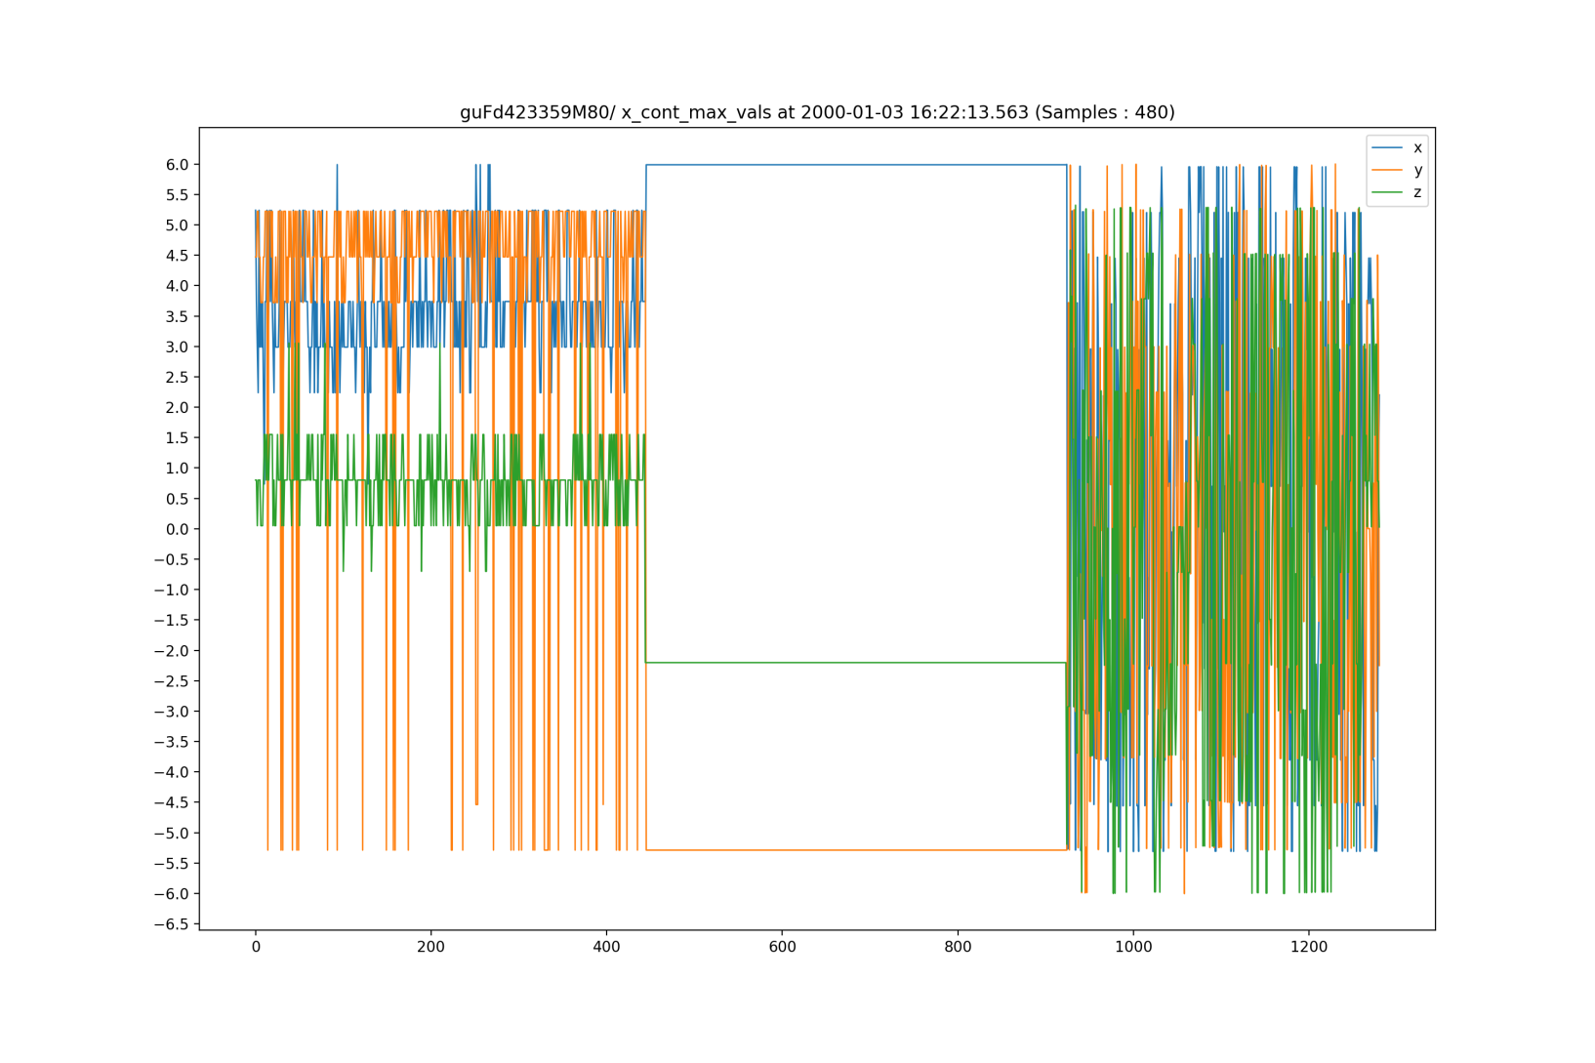
Examples of anomalous data
Continuous max
Instantaneous spikes
g
Interval fluctuations
Samples (80 Hz)

Slide 24
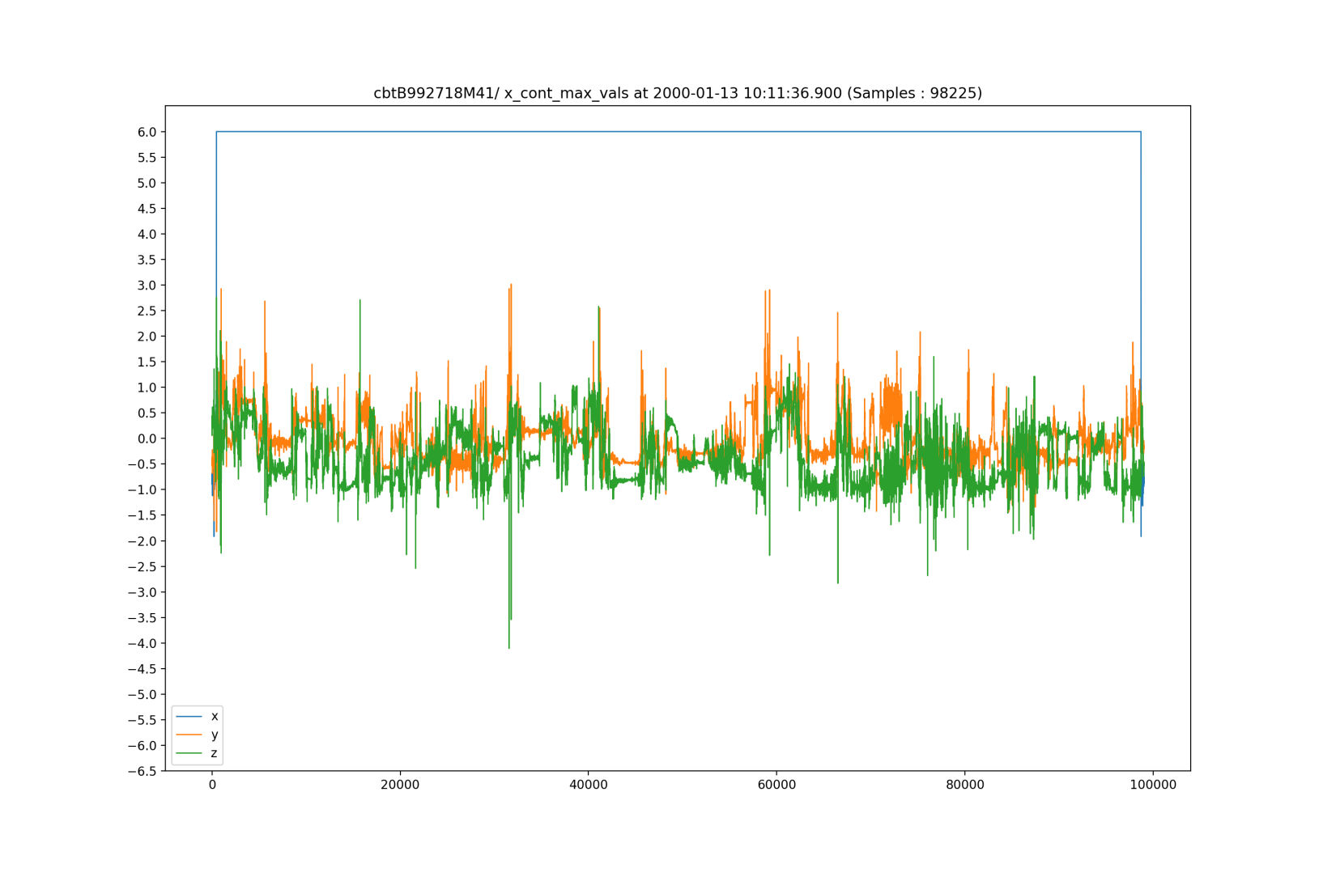
Anomalous data (continuous max (1 axis))
~ 20 minutes

Slide 25
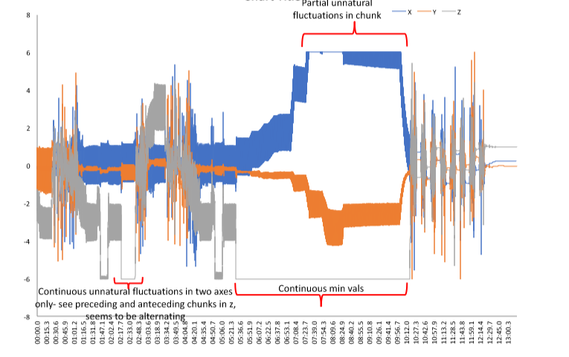
Anomalous data (multiple issues)
For anyone accustomed to looking at raw accelerometer data, portions of this look normal....
… and other parts do not

Slide 26
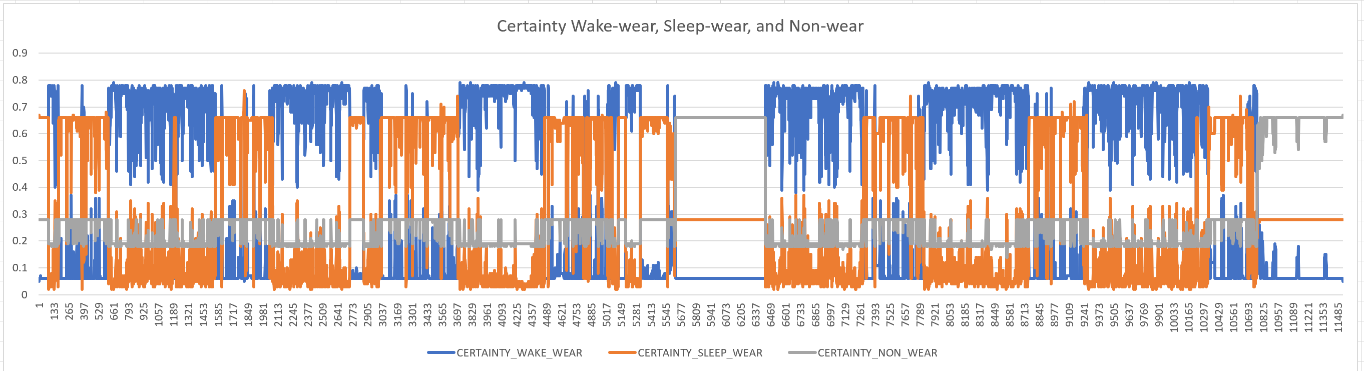
Algorithm outputs (un)certainty

